Slide 1
Dynamics and Mechanics of Rods(1st)
By JunAng Wang
2023/10/20

Slide 2
Recap
Laws of physics
Integration in time
Integration in space
Three dimensional continua and one dimensional continua
The Lagrange coordinate and Mechanics of a Rod

Slide 3
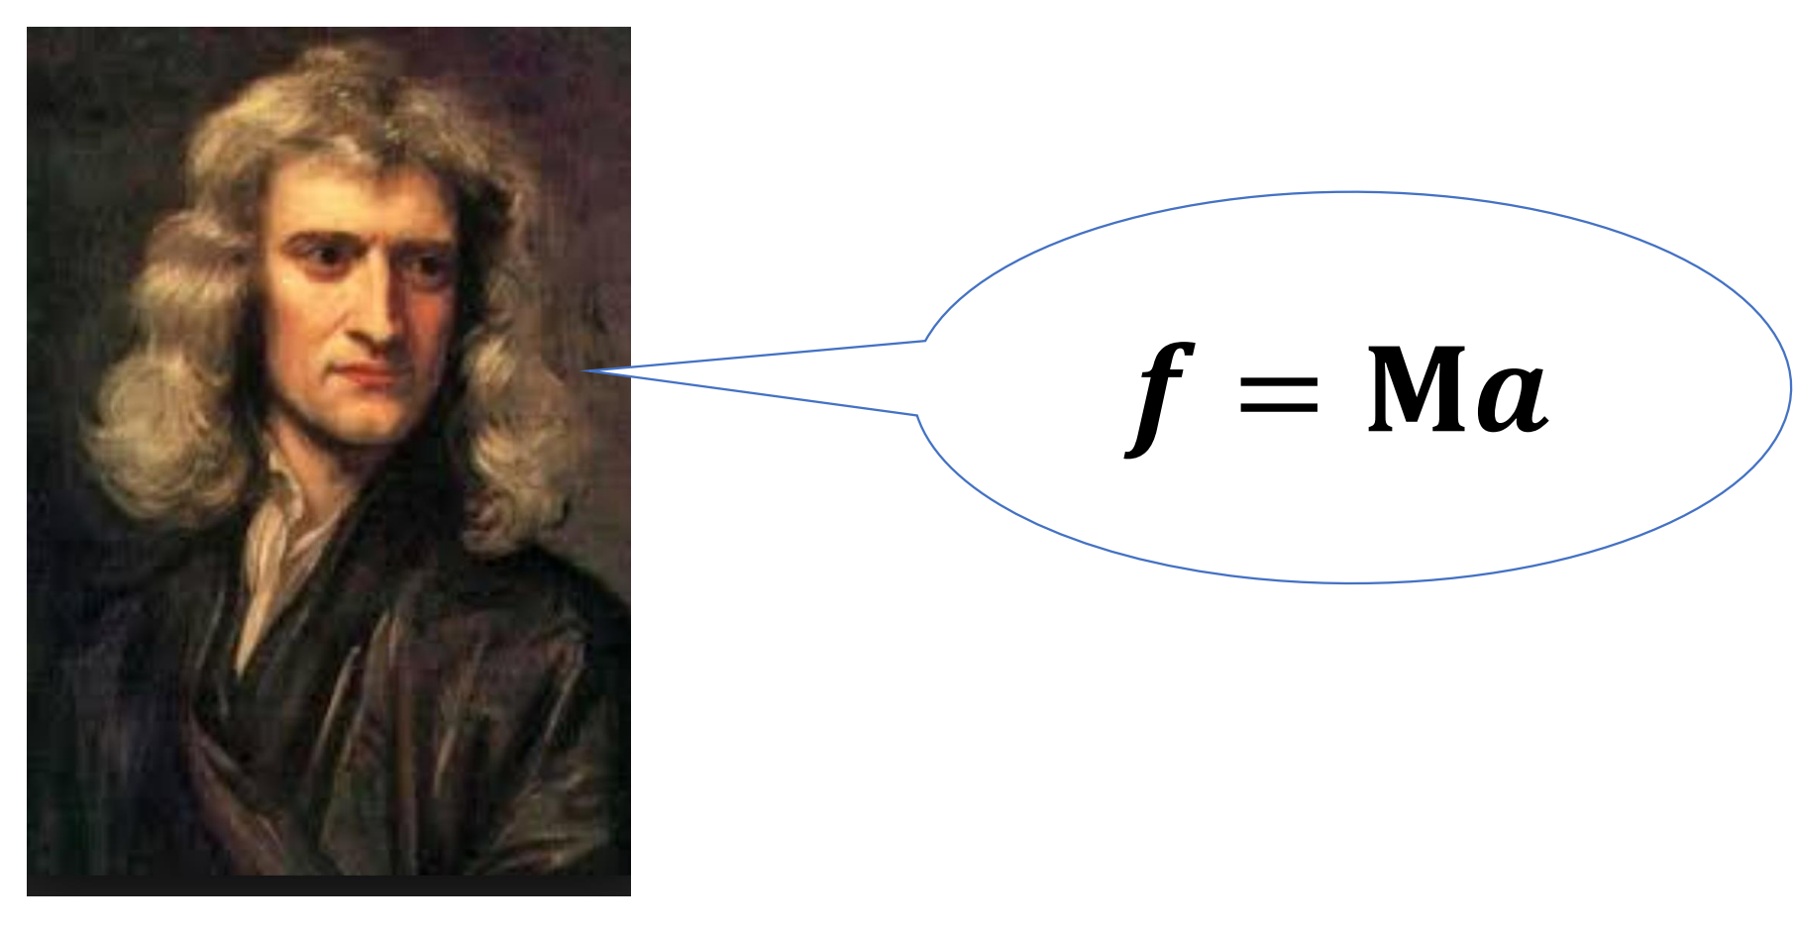
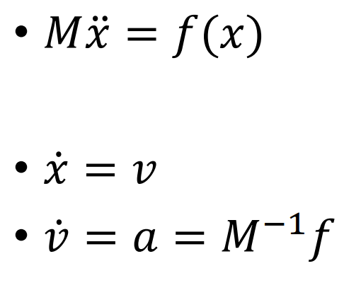
Recap
Laws of physics

Slide 4
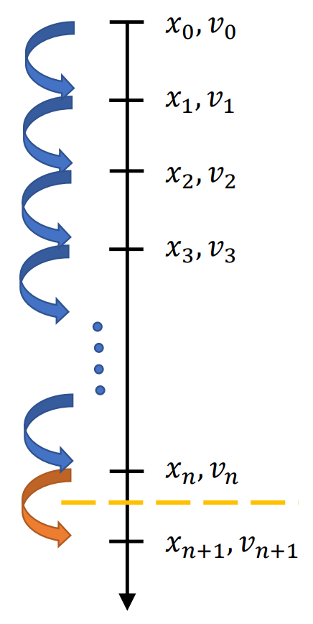
Recap
Laws of physics

Slide 5
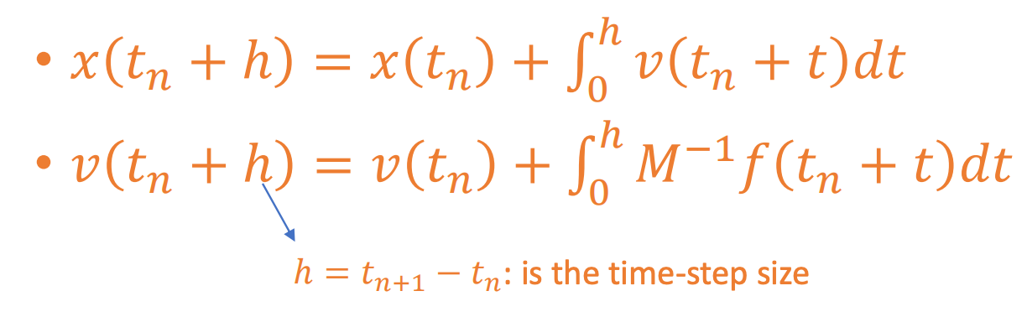
Recap
Laws of physics

Slide 6
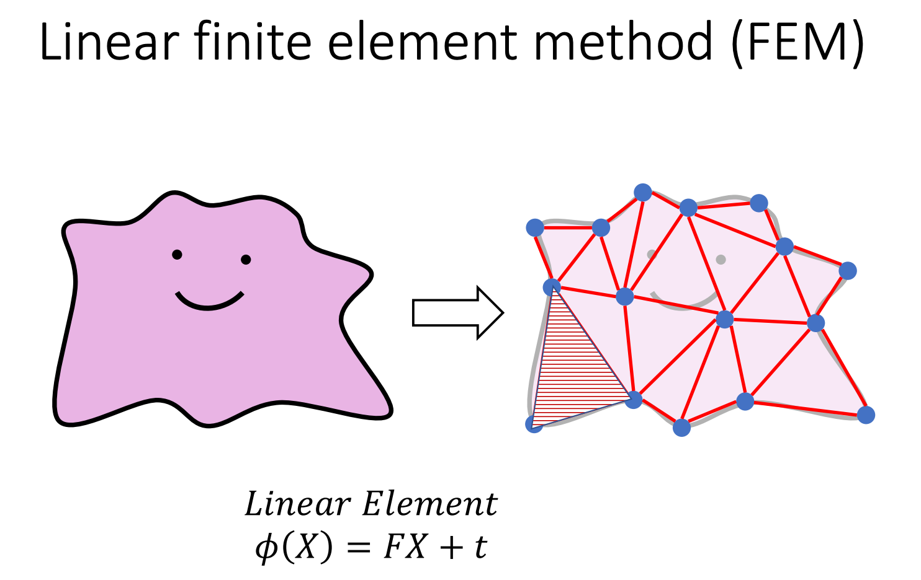

Slide 7
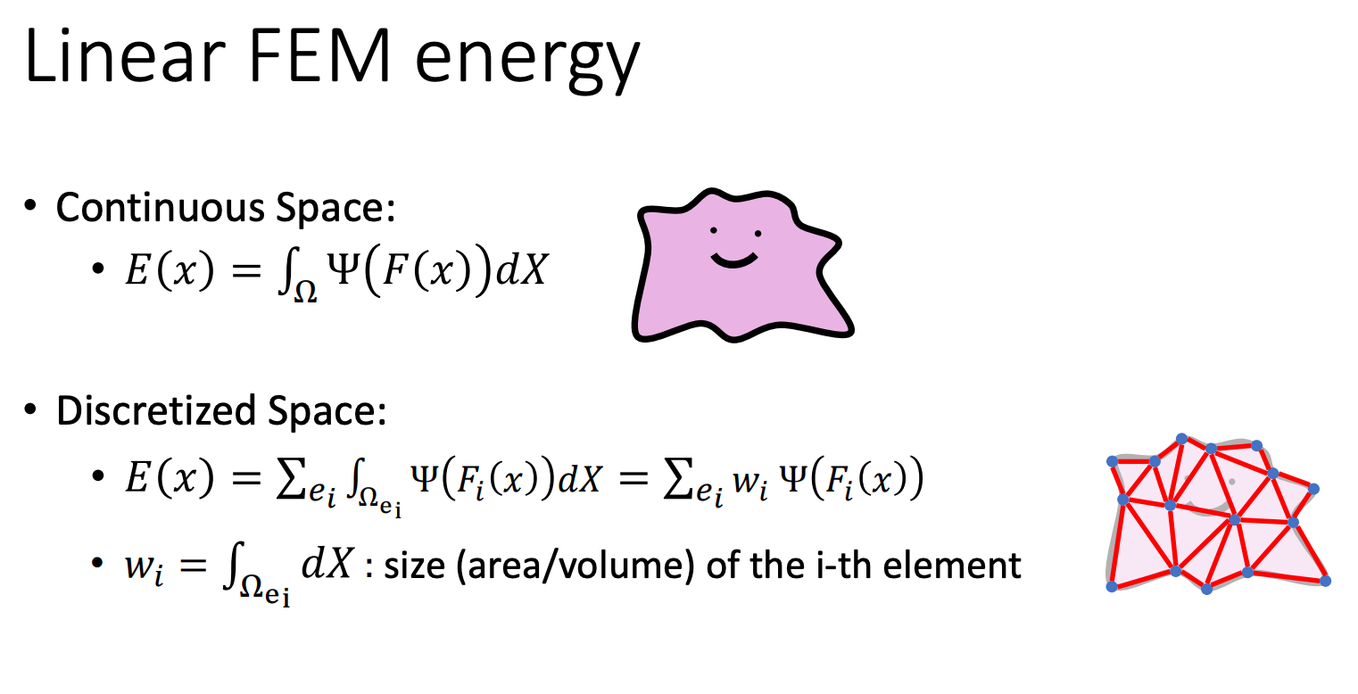

Slide 8
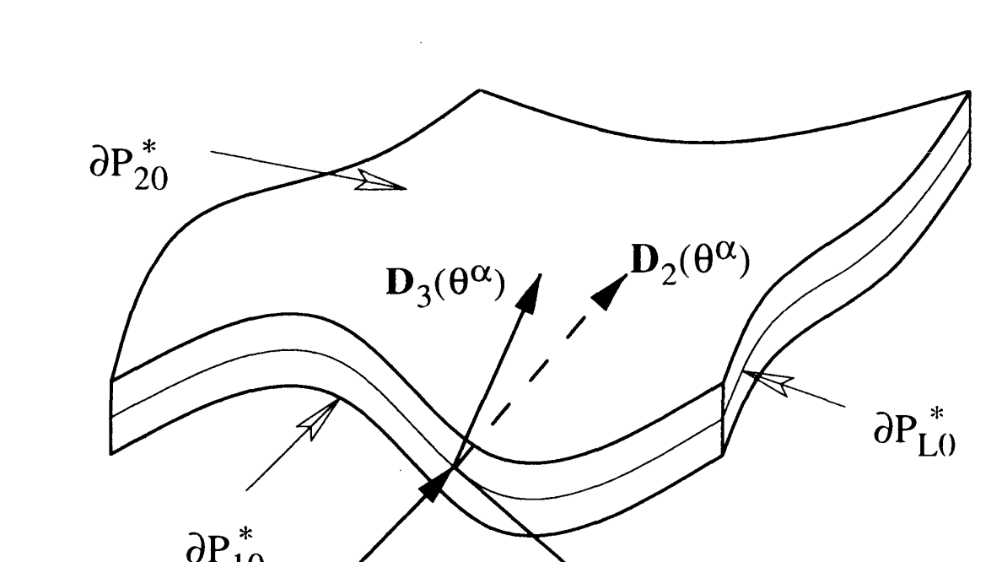
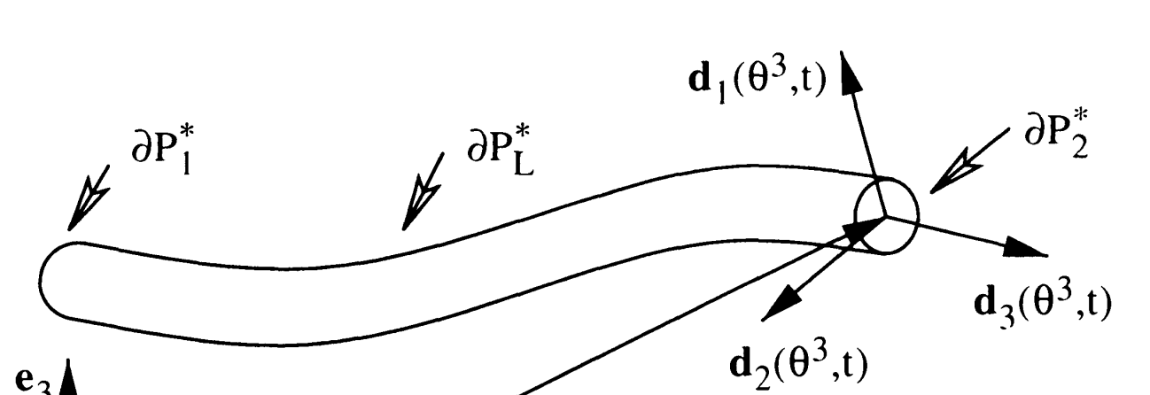
3D continua and 1D continua
M. B. Rubin, Cosserat Theories: Shells, Rods and Points

Slide 9
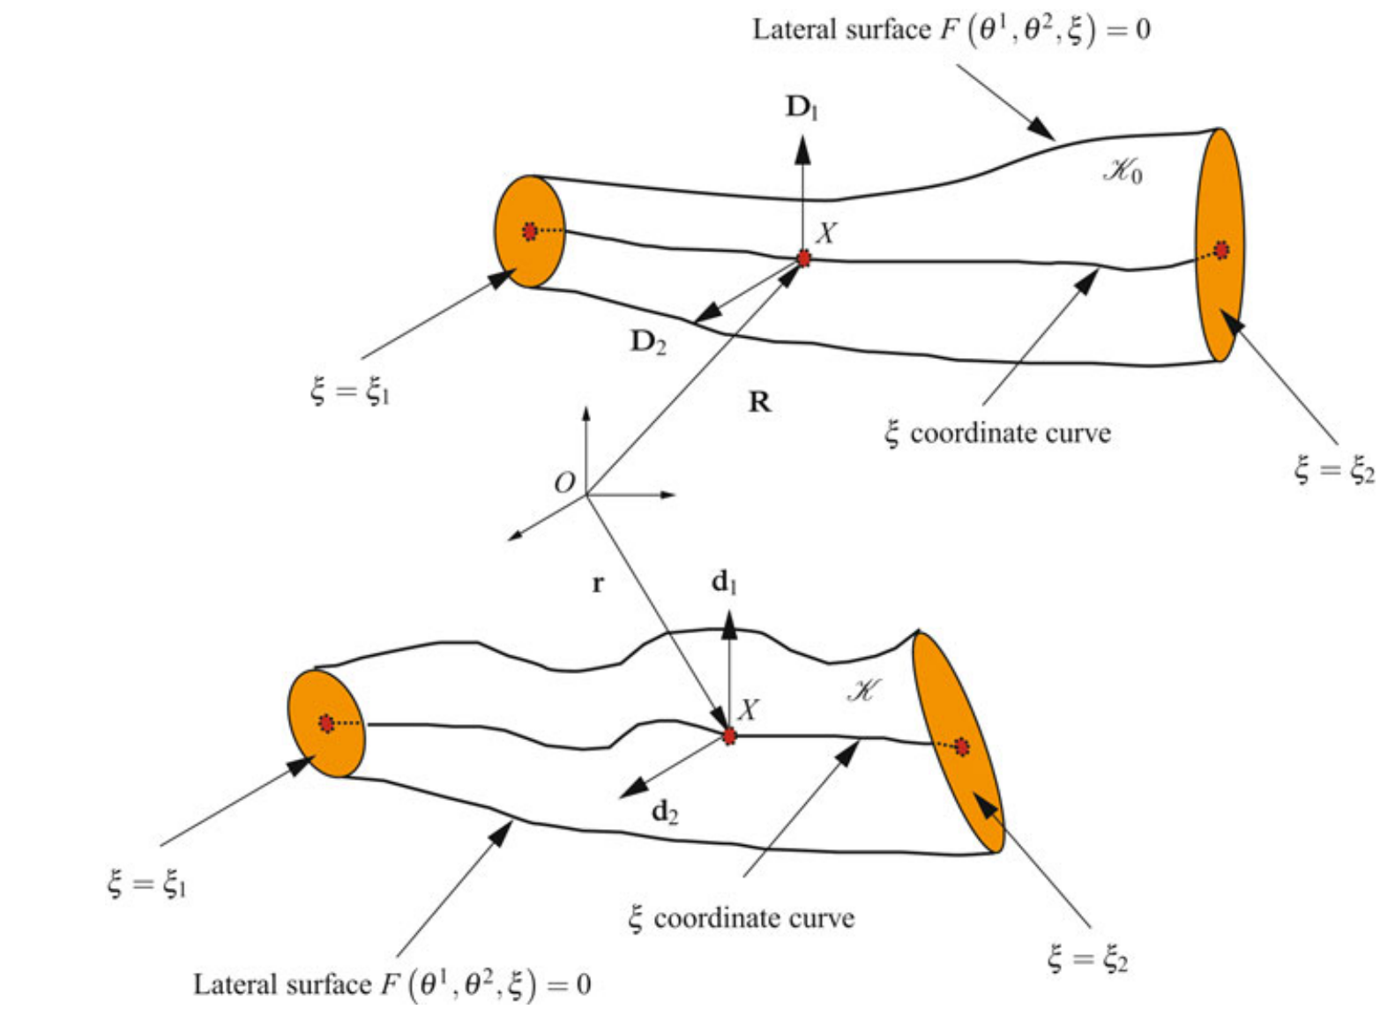
3D continua and 1D continua
M. B. Rubin, Cosserat Theories: Shells, Rods and Points

Slide 10
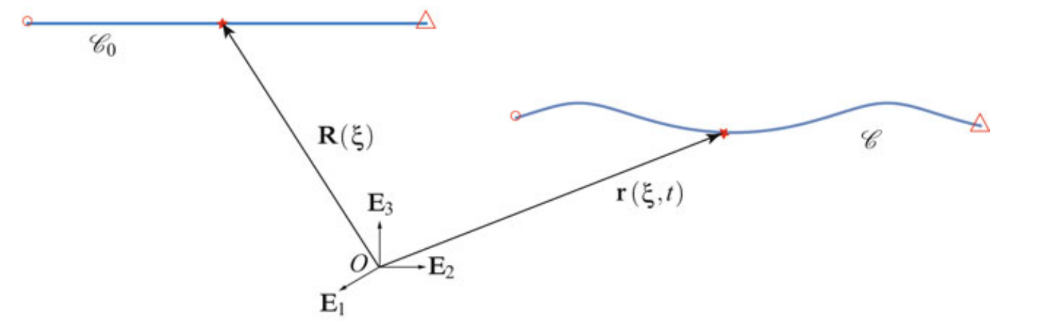
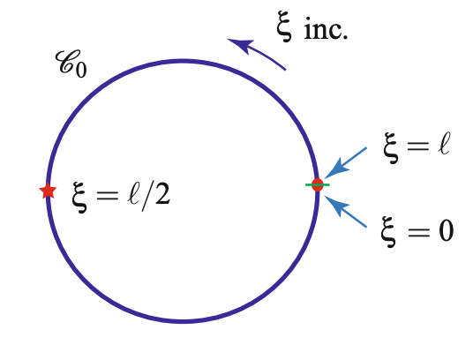
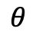
The Lagrange coordinate
$$θ$$
M. B. Rubin, Cosserat Theories: Shells, Rods and Points

Slide 11
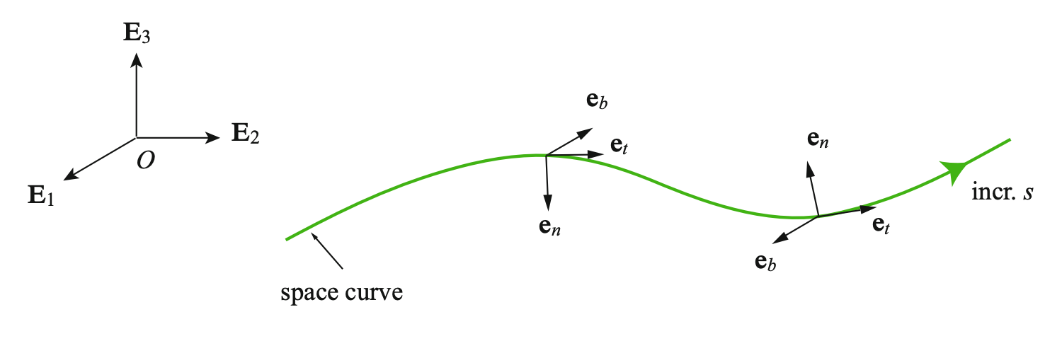
The Lagrange coordinate
M. B. Rubin, Cosserat Theories: Shells, Rods and Points

Slide 12
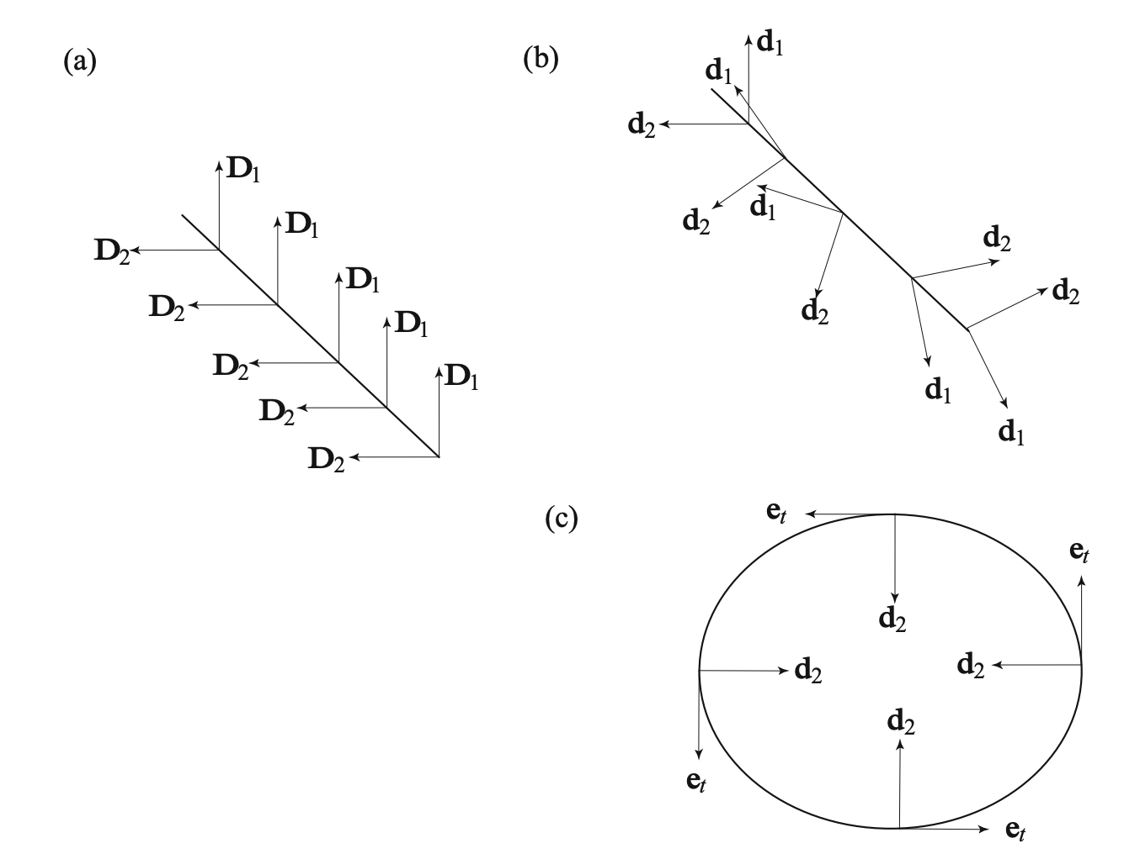
The Lagrange coordinate
M. B. Rubin, Cosserat Theories: Shells, Rods and Points

Slide 13
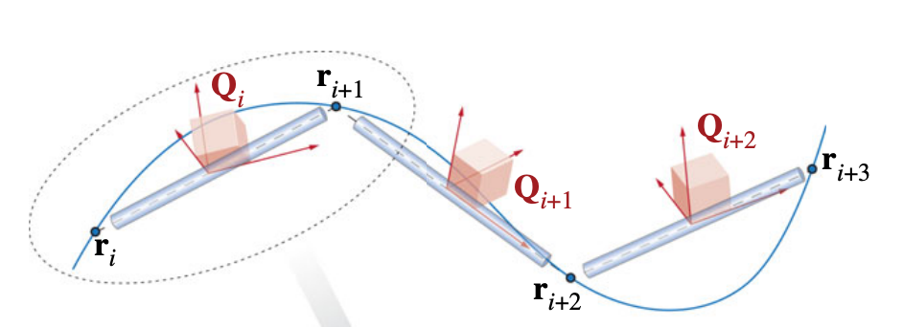
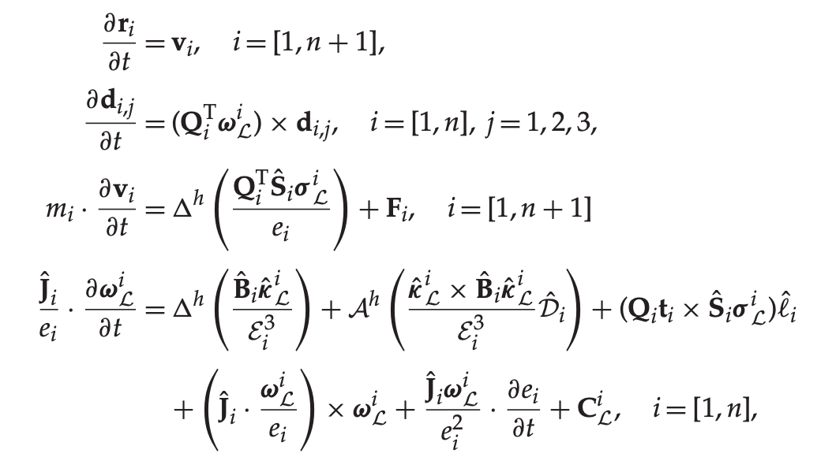
Mechanics of a Rod
M. B. Rubin, Cosserat Theories: Shells, Rods and Points

Slide 14
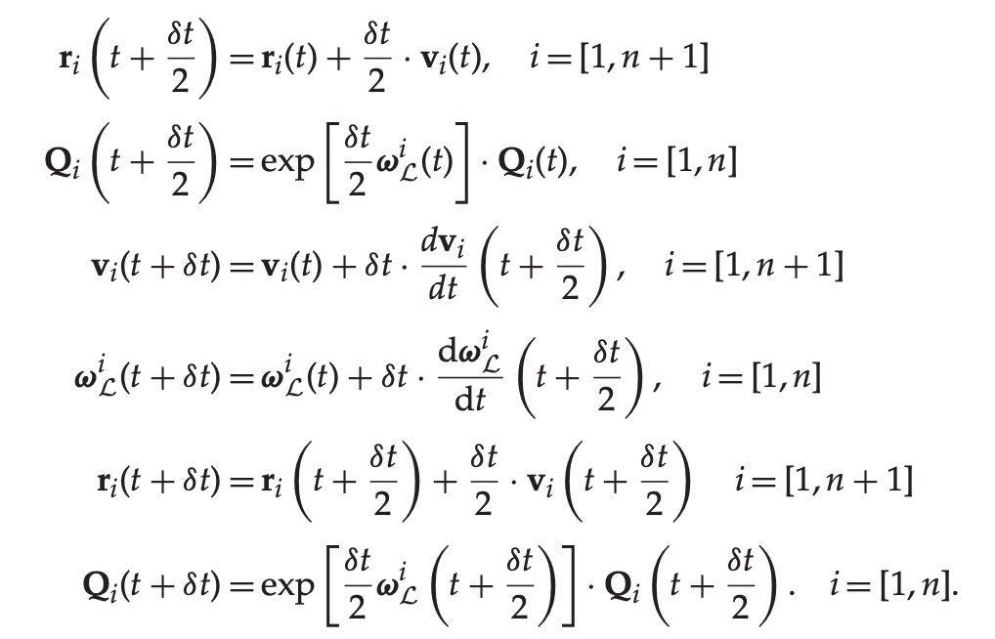
Time Integration (Symplectic, Verlet integrator)
M. B. Rubin, Cosserat Theories: Shells, Rods and Points

Slide 15
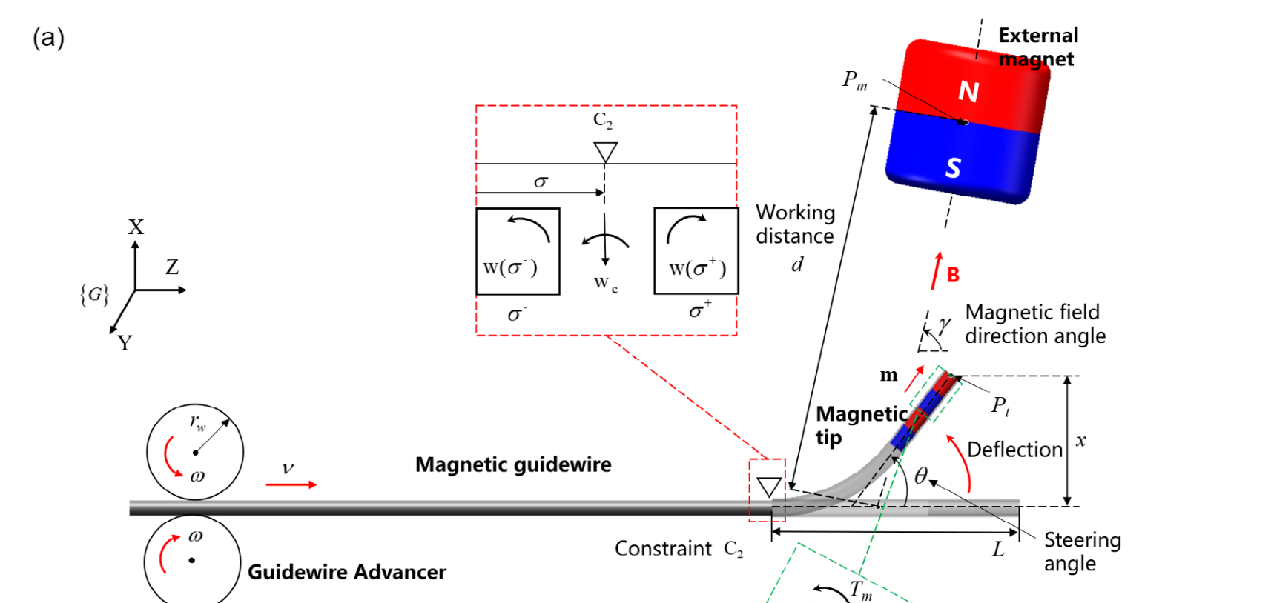
What we are studying at?
Fu, S., Xu, T. et al. 2023

Slide 16
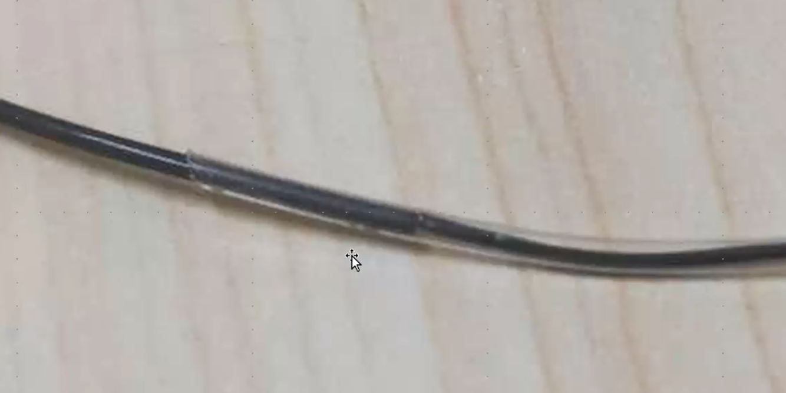
What we are studying at?
Fu, S., Xu, T. et al. 2023

Slide 17
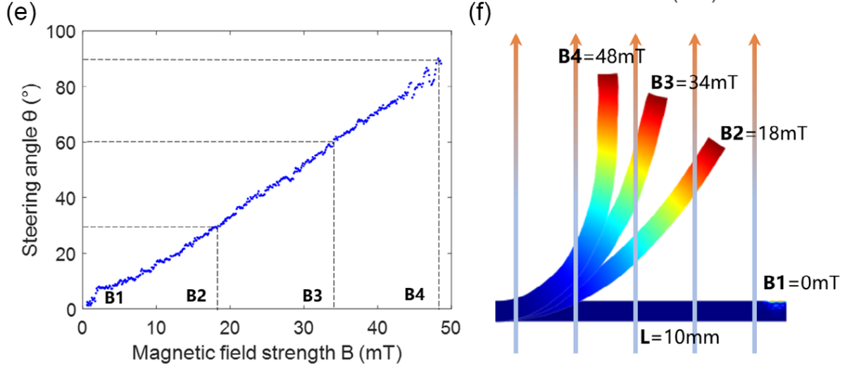
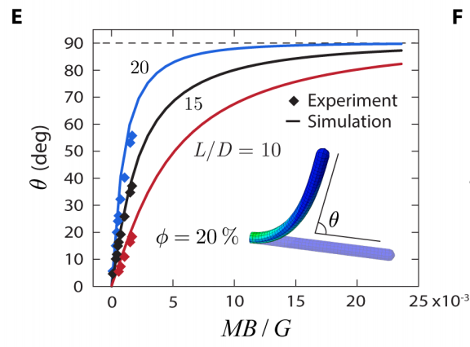
Reproduction
Fu, S., Xu, T. et al. 2023
Yoonho Kimet al. 2019

Slide 18
Outline
The difficulty of small scale rod simulation
Approximation method
Mechanics and Dynamics of Rods
Outlook

Slide 19
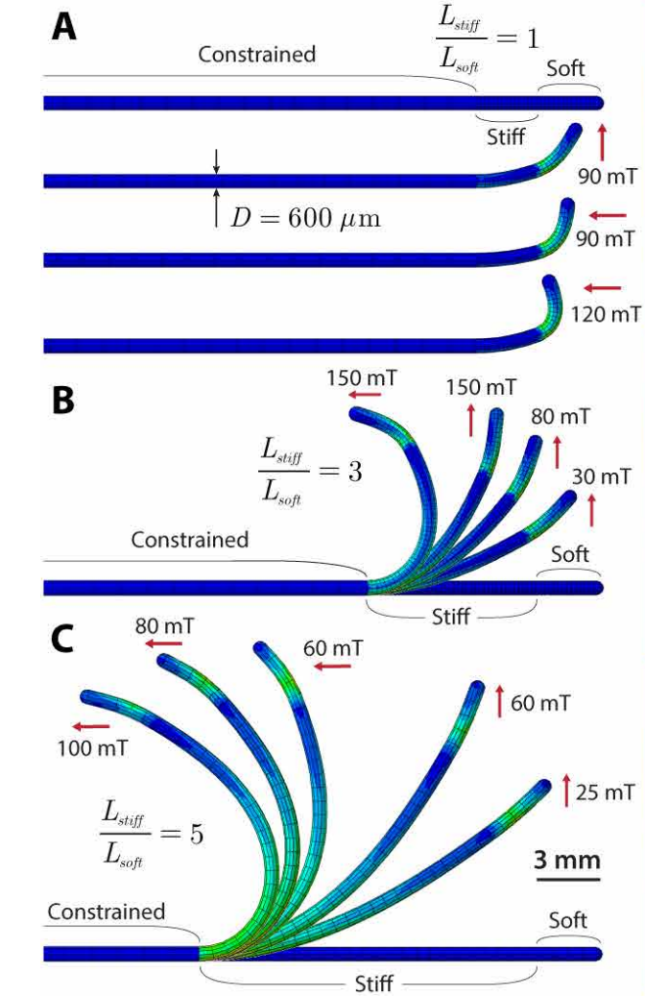
What we are studying at?
Yoonho Kimet al. 2019

Slide 20
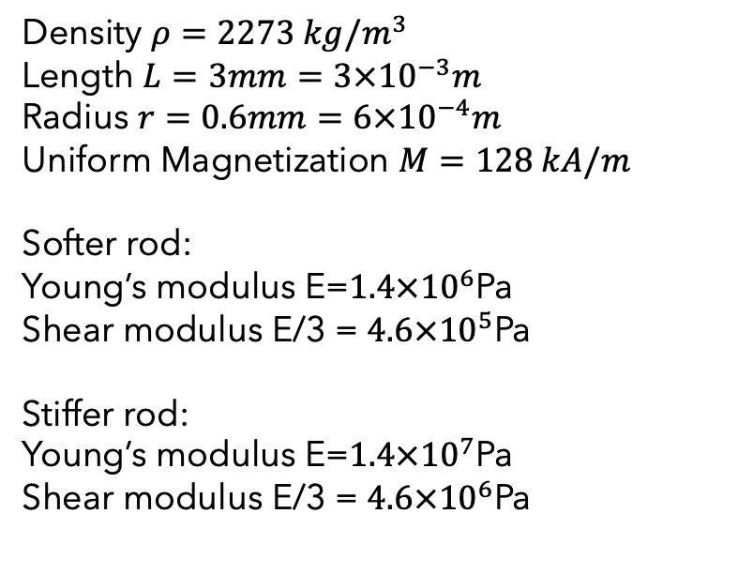
What we are studying at?
Density $ρ=2273 kg/m^{3}$
Length $L=3mm=3×{10}^{−3}m$
Radius $r=0.6mm=6×{10}^{−4}m$
Uniform Magnetization $M=128 kA/m$
Softer rod:
Young’s modulus E=$1.4×{10}^{6}$Pa
Shear modulus E/3 = $4.6×{10}^{5}$Pa
Stiffer rod:
Young’s modulus E=$1.4×{10}^{7}$Pa
Shear modulus E/3 = $4.6×{10}^{6}$Pa
Yoonho Kimet al. 2019

Slide 21
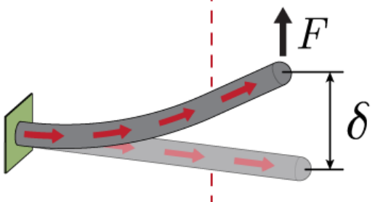
What we are studying at?
Density $ρ=2273 kg/m^{3}$
Length $L=3mm=3×{10}^{−3}m$
Radius $r=0.6mm=6×{10}^{−4}m$
Uniform Magnetization $M=128 kA/m$
Softer rod:
Young’s modulus E=$1.4×{10}^{6}$Pa
Shear modulus E/3 = $4.6×{10}^{5}$Pa
Stiffer rod:
Young’s modulus E=$1.4×{10}^{7}$Pa
Shear modulus E/3 = $4.6×{10}^{6}$Pa
Yoonho Kimet al. 2019

Slide 22
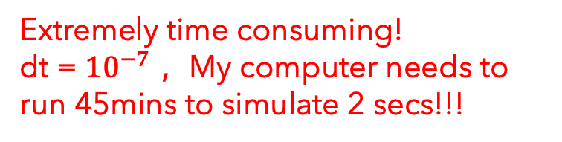
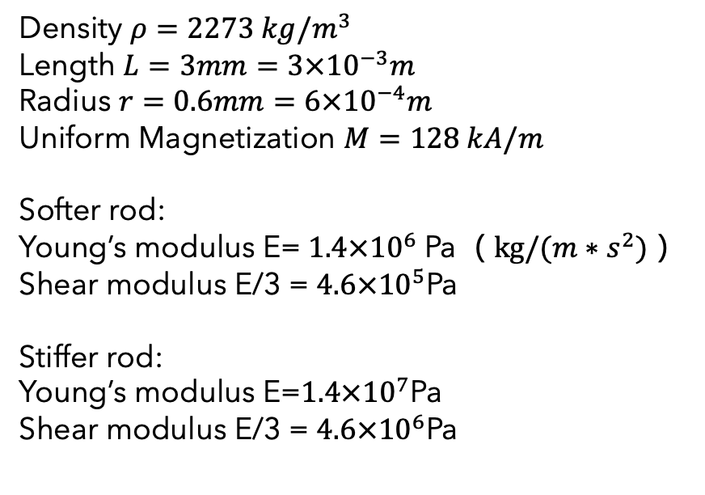
What we are studying at?
Density $ρ=2273 kg/m^{3}$
Length $L=3mm=3×{10}^{−3}m$
Radius $r=0.6mm=6×{10}^{−4}m$
Uniform Magnetization $M=128 kA/m$
Softer rod:
Young’s modulus E=$1.4×{10}^{6}$Pa（$kg/(m∗s^{2})$）
Shear modulus E/3 = $4.6×{10}^{5}$Pa
Stiffer rod:
Young’s modulus E=$1.4×{10}^{7}$Pa
Shear modulus E/3 = $4.6×{10}^{6}$Pa
Extremely time consuming!
dt = ${10}^{−7}$ ，My computer needs to run 45mins to simulate 2 secs!!!
Yoonho Kimet al. 2019

Slide 23
The difficulty of small scale rod simulation

Slide 24
The difficulty of small scale rod simulation

Slide 25
The difficulty of small scale rod simulation

Slide 26
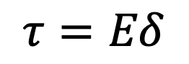
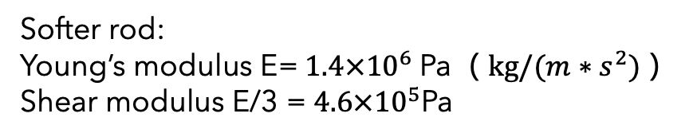
The difficulty of small scale rod simulation
$$τ=Eδ$$
Softer rod:
Young’s modulus E=$1.4×{10}^{6}$Pa（$kg/(m∗s^{2})$）
Shear modulus E/3 = $4.6×{10}^{5}$Pa

Slide 27
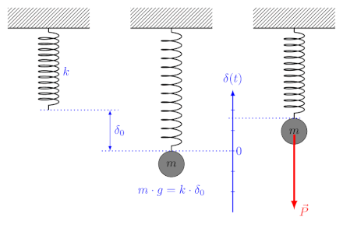
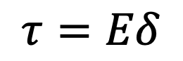
The difficulty of small scale rod simulation
$$τ=Eδ$$
（1）
Softer rod:
Young’s modulus E=$1.4×{10}^{6}$Pa（$kg/(m∗s^{2})$）
Shear modulus E/3 = $4.6×{10}^{5}$Pa

Slide 28
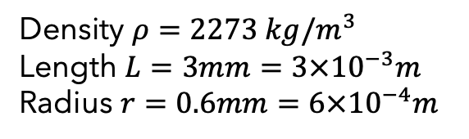
The difficulty of small scale rod simulation
（1）
Softer rod:
Young’s modulus E=$1.4×{10}^{6}$Pa（$kg/(m∗s^{2})$）
Shear modulus E/3 = $4.6×{10}^{5}$Pa
（2）
Density $ρ=2273 kg/m^{3}$
Length $L=3mm=3×{10}^{−3}m$
Radius $r=0.6mm=6×{10}^{−4}m$

Slide 29
The difficulty of small scale rod simulation
（1）
Softer rod:
Young’s modulus E=$1.4×{10}^{6}$Pa（$kg/(m∗s^{2})$）
Shear modulus E/3 = $4.6×{10}^{5}$Pa
（2）
Density $ρ=2273 kg/m^{3}$
Length $L=3mm=3×{10}^{−3}m$
Radius $r=0.6mm=6×{10}^{−4}m$
double-precision float arithmetic issues !!!

Slide 30
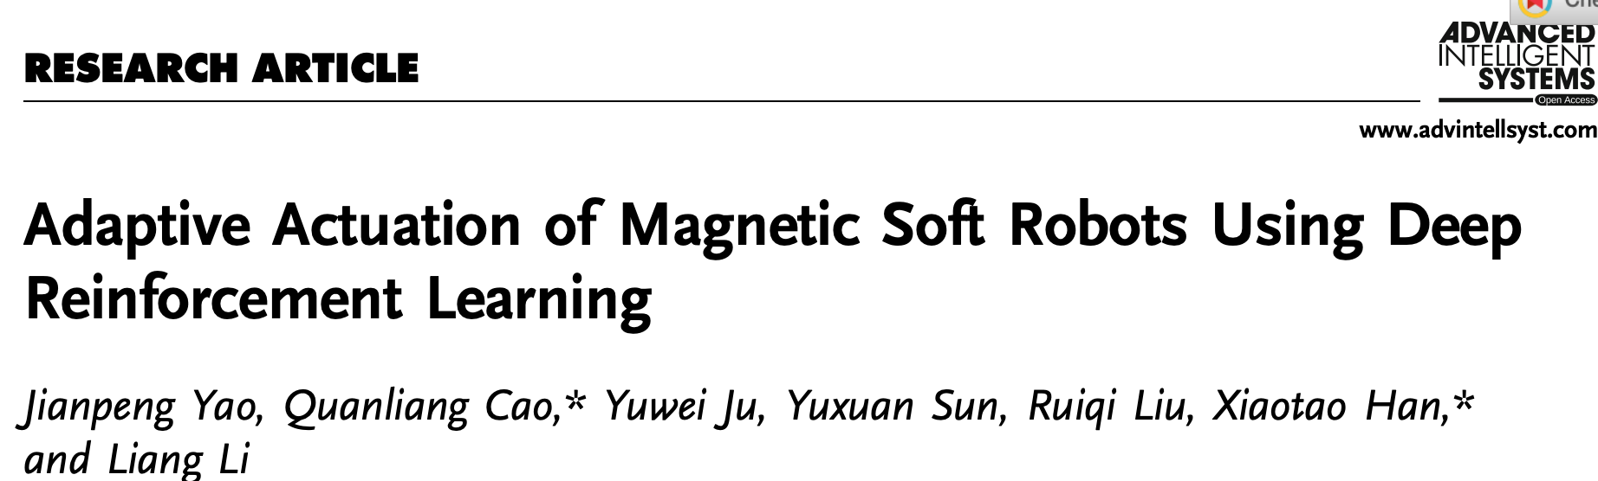
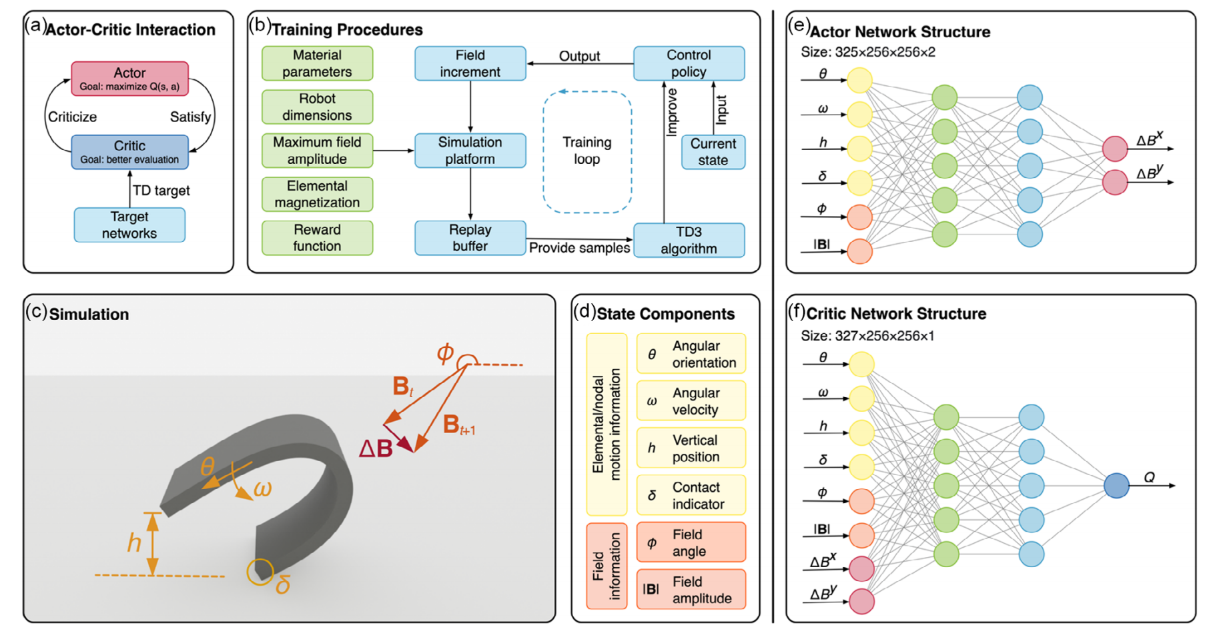
The difficulty of small scale rod simulation
Yao, Jianpeng, et al (2023)

Slide 31
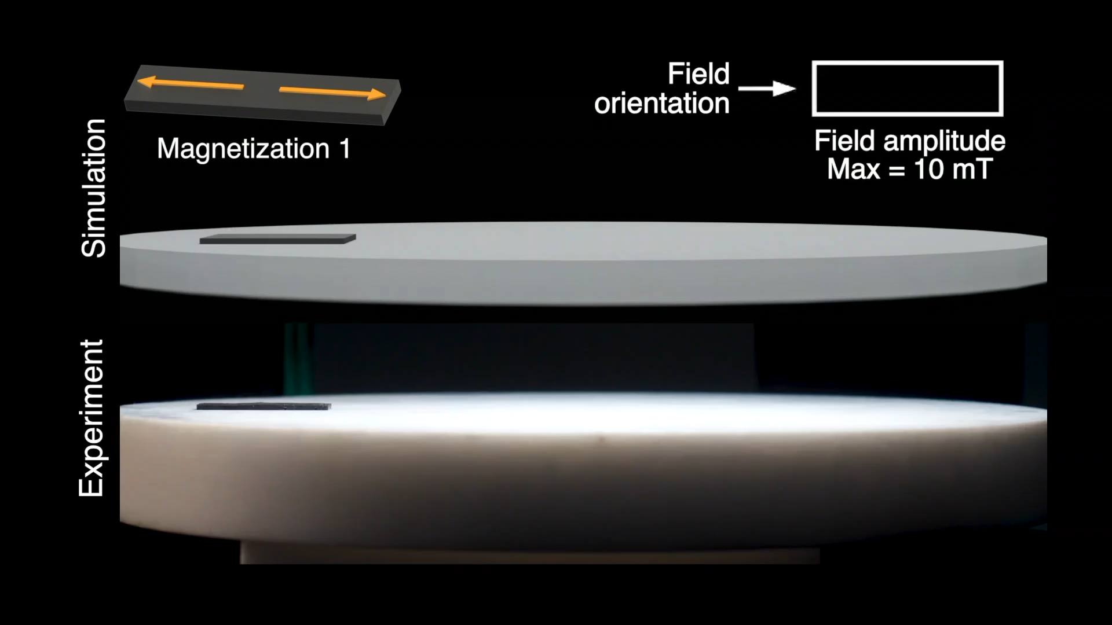
The difficulty of small scale rod simulation
Yao, Jianpeng, et al (2023)

Slide 32
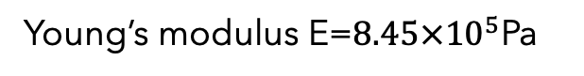
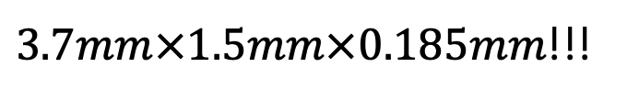
The difficulty of small scale rod simulation
Young’s modulus E=$8.45×{10}^{5}$Pa
Yao, Jianpeng, et al (2023)
$3.7mm×1.5mm×0.185mm$!!!

Slide 33
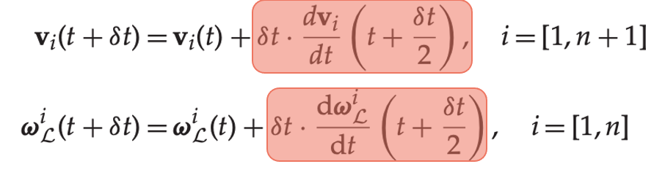

Approximation method
https://github.com/alantes/RL-for-MSRs/issues/2
$$F=ma$$

Slide 34
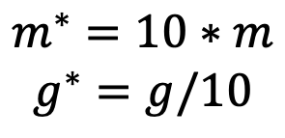
Approximation method
https://github.com/alantes/RL-for-MSRs/issues/2
$$F=ma$$
$$m^{∗}=10∗m$$
$$g^{∗}=g/10$$

Slide 35
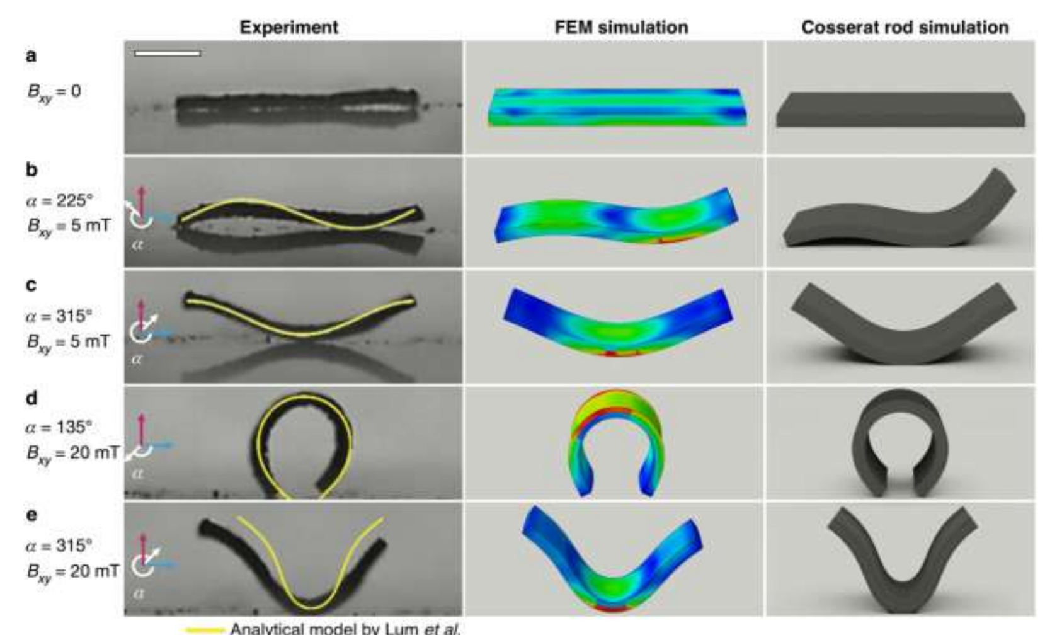
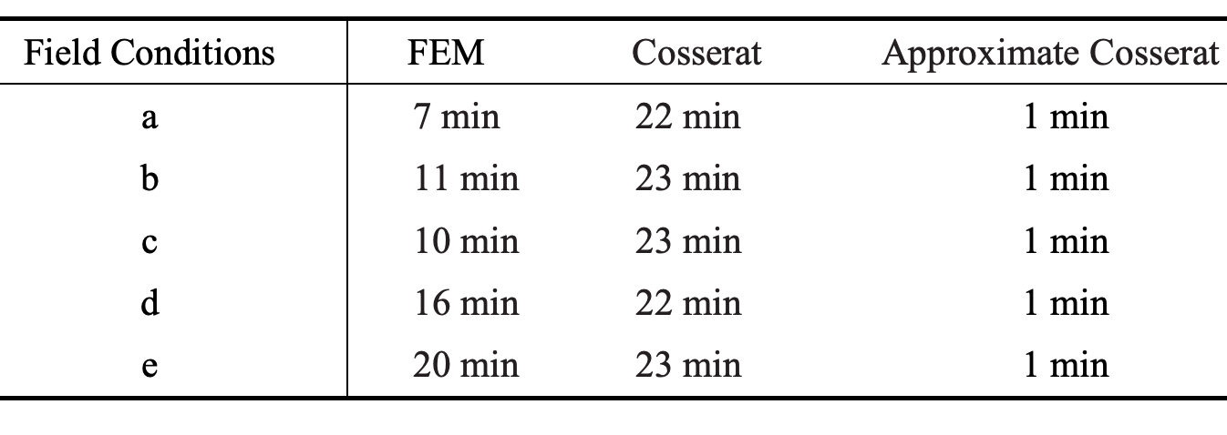
Approximation method
https://github.com/alantes/RL-for-MSRs/issues/2
$$F=ma$$
$$m^{∗}=10∗m$$
$$g^{∗}=g/10$$
Yao, Jianpeng, et al (2023)

Slide 36
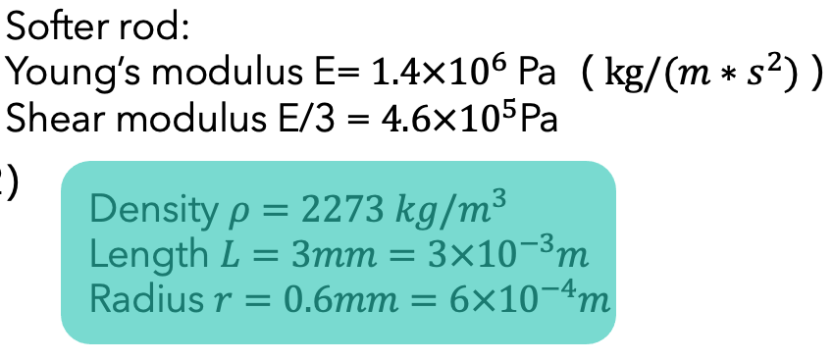
Approximation method
https://github.com/GazzolaLab/PyElastica/issues/310

Slide 37
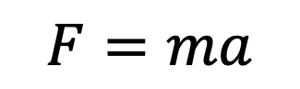
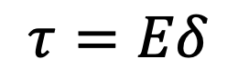
Approximation method
https://github.com/GazzolaLab/PyElastica/issues/310
$$F=ma$$
$$τ=Eδ$$

Slide 38
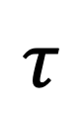
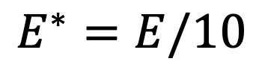
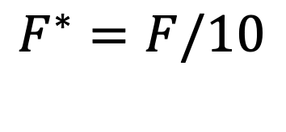
Approximation method
https://github.com/GazzolaLab/PyElastica/issues/310
$$F=ma$$
$$τ=Eδ$$
$$E^{∗}=E/10$$
$$F^{∗}=F/10$$
$$τ$$
Yoonho Kimet al. 2019

Slide 39
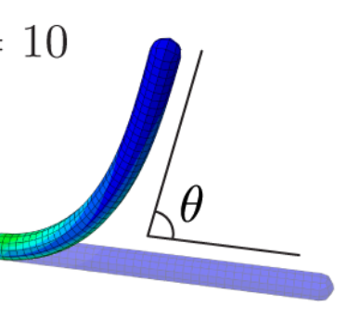
Mechanics and Dynamics of Rods
Yoonho Kimet al. 2019

Slide 40
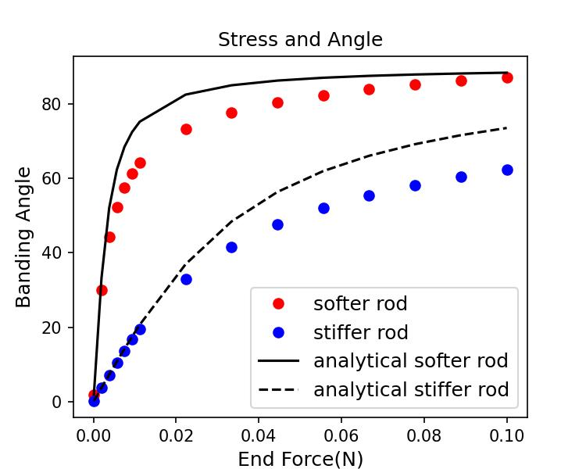
Mechanics and Dynamics of Rods
Yoonho Kimet al. 2019

Slide 41
Mechanics and Dynamics of Rods
Yoonho Kimet al. 2019
My computer run 19 secs to simulate 15 secs!!!

Slide 42
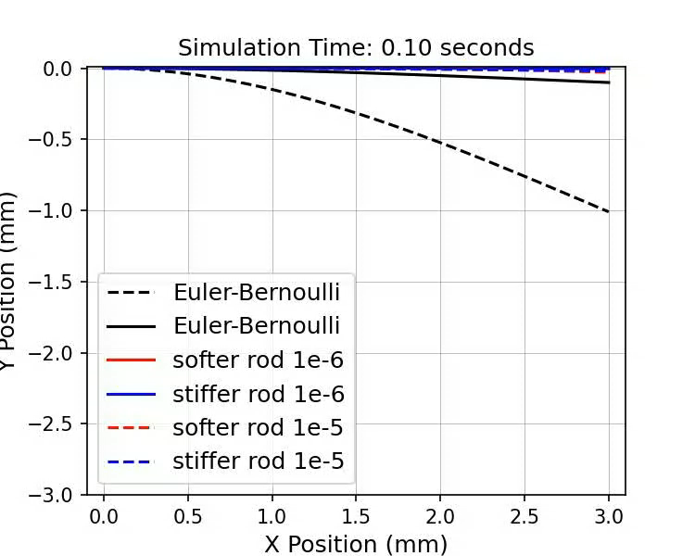
Mechanics and Dynamics of Rods

Slide 43
Remark
The difficulty of small scale rod simulation
Approximation method
Mechanics and Dynamics of Rods

Slide 44
Outlook
Using FEM(Comsol, Abaqus) to check the accuracy
Reproduction
Yoonho Kimet al. 2019

Slide 45
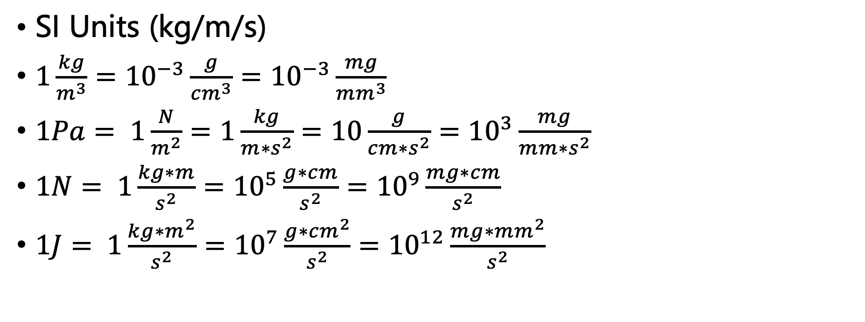
References
SI Units (kg/m/s)
$1\frac{kg}{m^{3}}={10}^{−3}\frac{g}{{cm}^{3}}={10}^{−3}\frac{mg}{{mm}^{3}}$
$1Pa= 1\frac{N}{m^{2}}=1\frac{kg}{m∗s^{2}}=10\frac{g}{{cm∗s}^{2}}={10}^{3}\frac{mg}{{mm∗s}^{2}}$
$1N= 1\frac{kg∗m}{s^{2}}={10}^{5}\frac{g∗cm}{s^{2}}={10}^{9}\frac{mg∗cm}{s^{2}}$
$1J= 1\frac{kg∗m^{2}}{s^{2}}={10}^{7}\frac{g∗{cm}^{2}}{s^{2}}={10}^{12}\frac{mg∗{mm}^{2}}{s^{2}}$

